Slide 1

ECE 530 Cloud Computing
Ioannis Papapanagiotou
Consistency

Slide 2
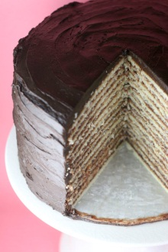
Recall that clouds have tiers
Up to now our focus has been on client systems and the network, and the way that the cloud has reshaped both
We looked very superficially at the tiered structure of the cloud itself
Tier 1: Very lightweight, responsive “web page builders” that can also route (or handle) “web services” method invocations. Limited to “soft state”.
Tier 2: (key,value) stores and similar services that support tier 1. Basically, various forms of caches.
Inner tiers: Online services that handle requests not handled in the first tier. These can store persistent files, run transactional services. But we shield them from load.
Back end: Runs offline services that do things like indexing the web overnight for use by tomorrow morning’s tier-1 services.

Slide 3

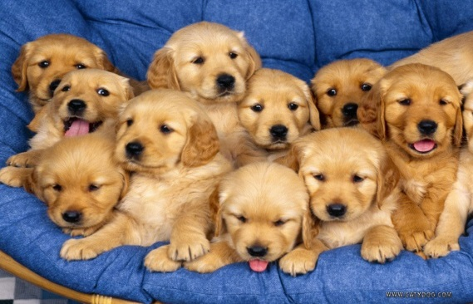
Replication
A central feature of the cloud
To handle more work, make more copies
In the first tier, which is highly elastic, data center management layer pre-positions inactive copies of virtual machines for the services we might run
Exactly like installing a program on some machine
If load surges, creating more instances just entails
Running more copies on more nodes
Adjusting the load-balancer to spray requests to new nodes
If load drops... just kill the unwanted copies!
Little or no warning. Discard any “state” they created locally.

Slide 4
Things we can replicate in a cloud
Files or other forms of data used to handle requests
If all our first tier systems replicate the data needed for end-user requests, then they can handle all the work!
Two cases to consider: in one the data itself is “write once” like a photo. Either you have a replica, or don’t
In the other the data evolves over time, like the current inventory count for the latest iPad in the Apple store
Computation
Here we replicate some request and then the work of computing the answer can be spread over multiple programs in the cloud
We benefit from parallelism by getting a faster answer
Can also provide fault-tolerance

Slide 5
Many things “map” to replication
As we just saw, data (or databases), computation
Fault-tolerant request processing
Coordination and synchronization (e.g. “who’s in charge of the air traffic control sector over Paris?”)
Parameters and configuration data
Security keys and lists of possible users and the rules for who is permitted to do what
Membership information in a DHT or some other service that has many participants

Slide 6
Concept of “consistency”
We would say that a replicated entity behave in a consistent manner if mimics the behavior of a non-replicated entity
E.g. if I ask it some question, and it answers, and then you ask it that question, your answer is either the same or reflects some update to the underlying state
Many copies but acts like just one
An inconsistent service is one that seems “broken”

Slide 7
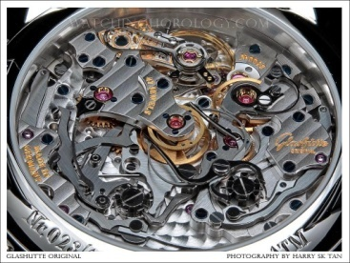


Consistency lets us ignore implementation
A consistent distributed system will often have many components, but users observe behavior indistinguishable from that of a single-component reference system
Reference Model
Implementation

Slide 8

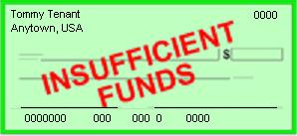
Dangers of Inconsistency
My rent check bounced?
That can’t be right!
Inconsistency causes bugs
Clients would never be able to trust servers… a free-for-all
Weak or “best effort” consistency?
Common in today’s cloud replication schemes
But strong security guarantees demand consistency
Would you trust a medical electronic-health records system or a bank that used “weak consistency” for better scalability?
Jason Fane Properties 1150.00
Sept 2009 Tommy Tenant

